Slide 1
Drink & Delight
Inventory Management Improvement System

Slide 2
TEAM C
ASTHA
PULAK SINHA
SAGAR SHARMA
SHIVAM TEWARI
TANISHA SINGH

Slide 3
EPIC & User Stories
EPIC 1: Finished Product Inventory Management:
User story 1: Collect finished product details.
User story 2: Add product .
User story 3: Update product details.
User story 4: Search product by name.
User story 6: Delete product.
User story 7: Get list of all products.

Slide 4
EPIC & User Stories(Contd.)
EPIC 2: Product Order Management:
User story 1: Receive product order from distributer
User story 2: Payment confirmation
User story 3: Generate product order ID
User story 4: Generate product order bill with all details including estimate date of delivery.
User story 4: Search order by order id
User story 5: Get a list of all orders

Slide 5
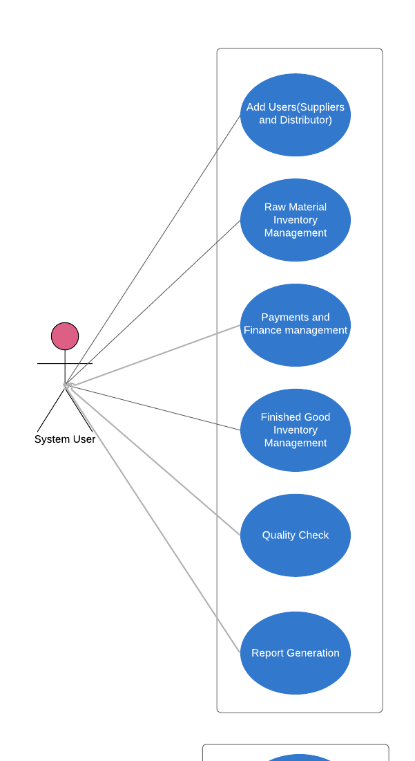
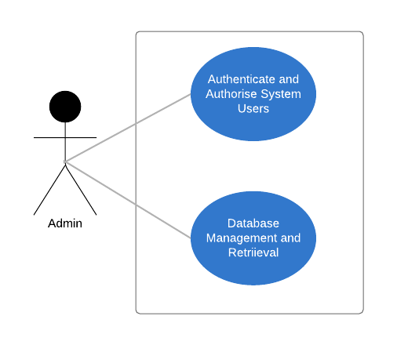
USE CASE Diagram:

Slide 6
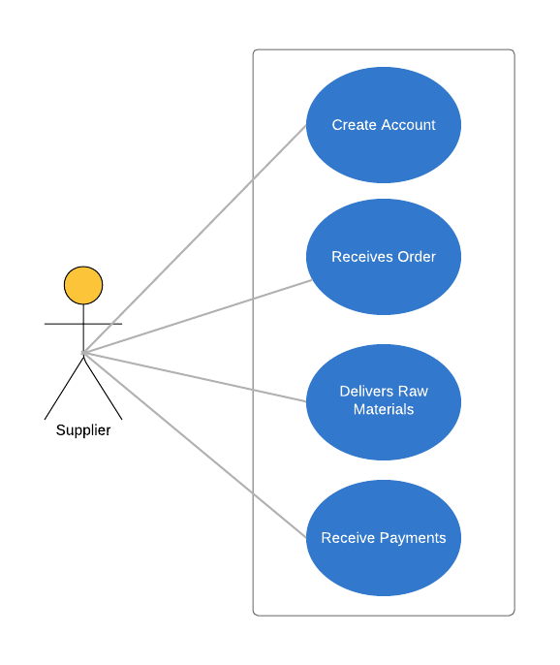
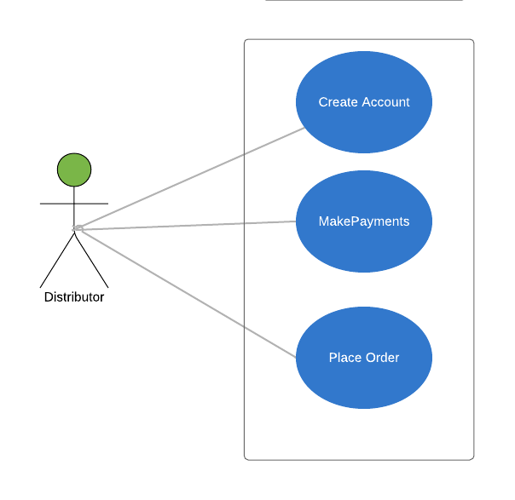

Slide 7
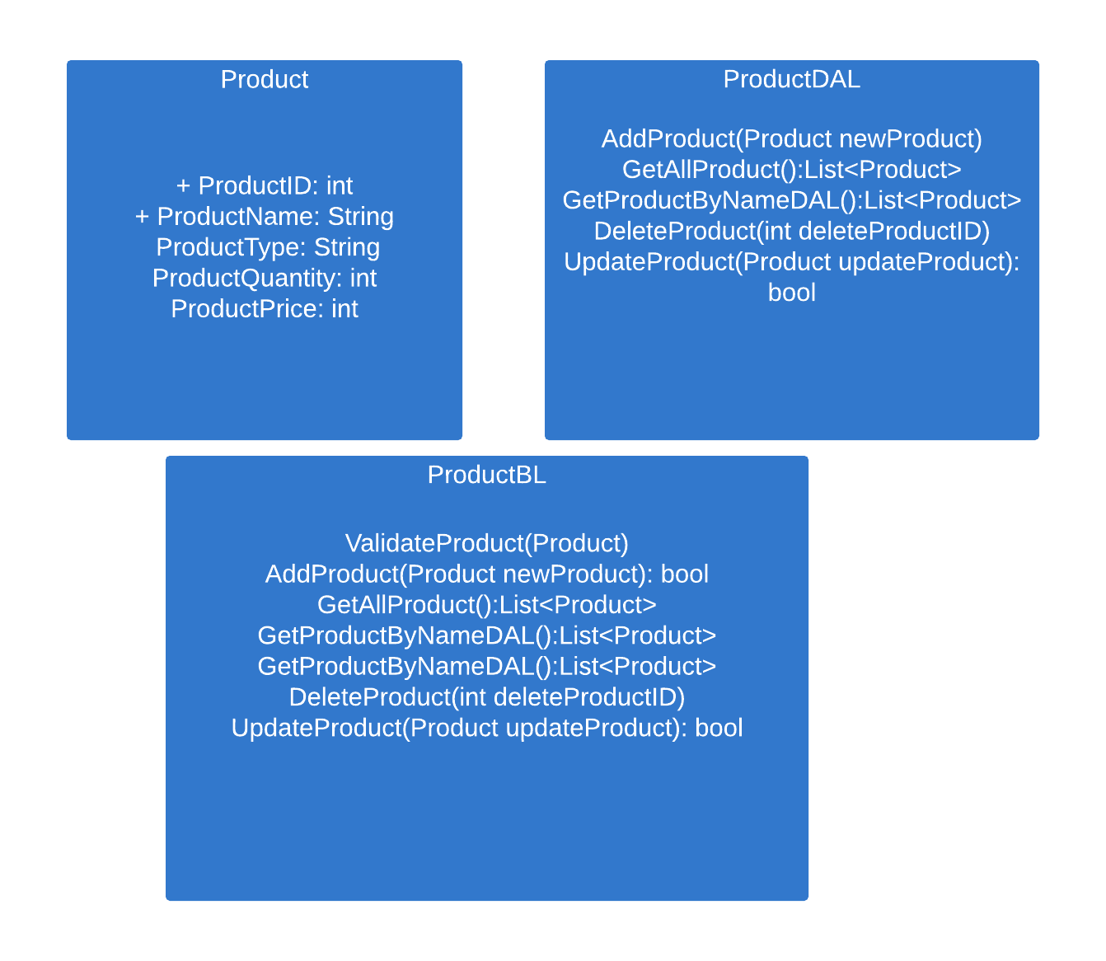
Class Diagram: Product class

Slide 8
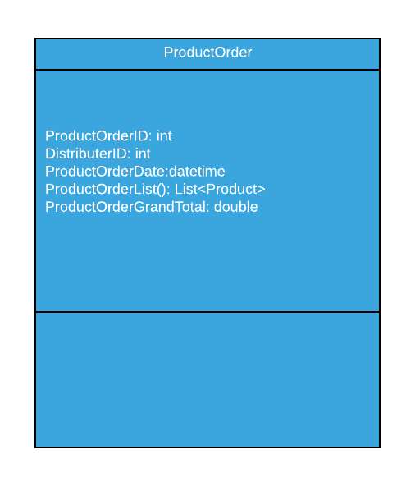
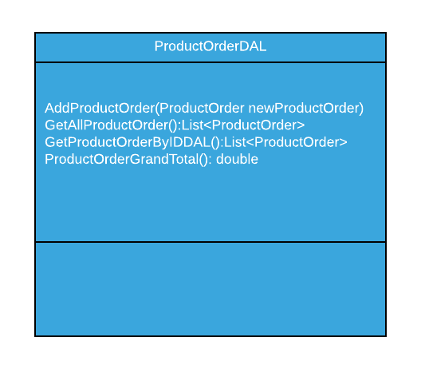
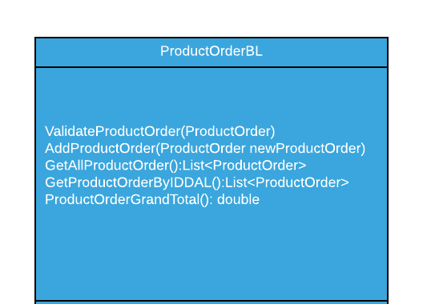
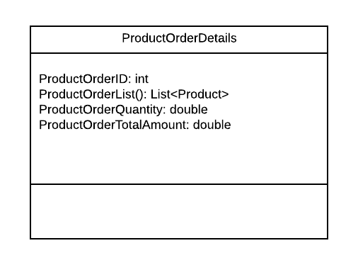
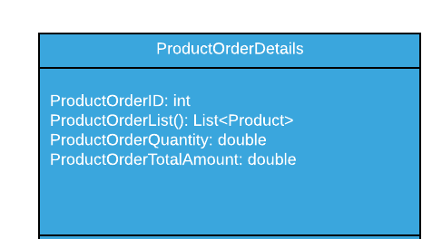
Class Diagram : Product Order Class

Slide 9
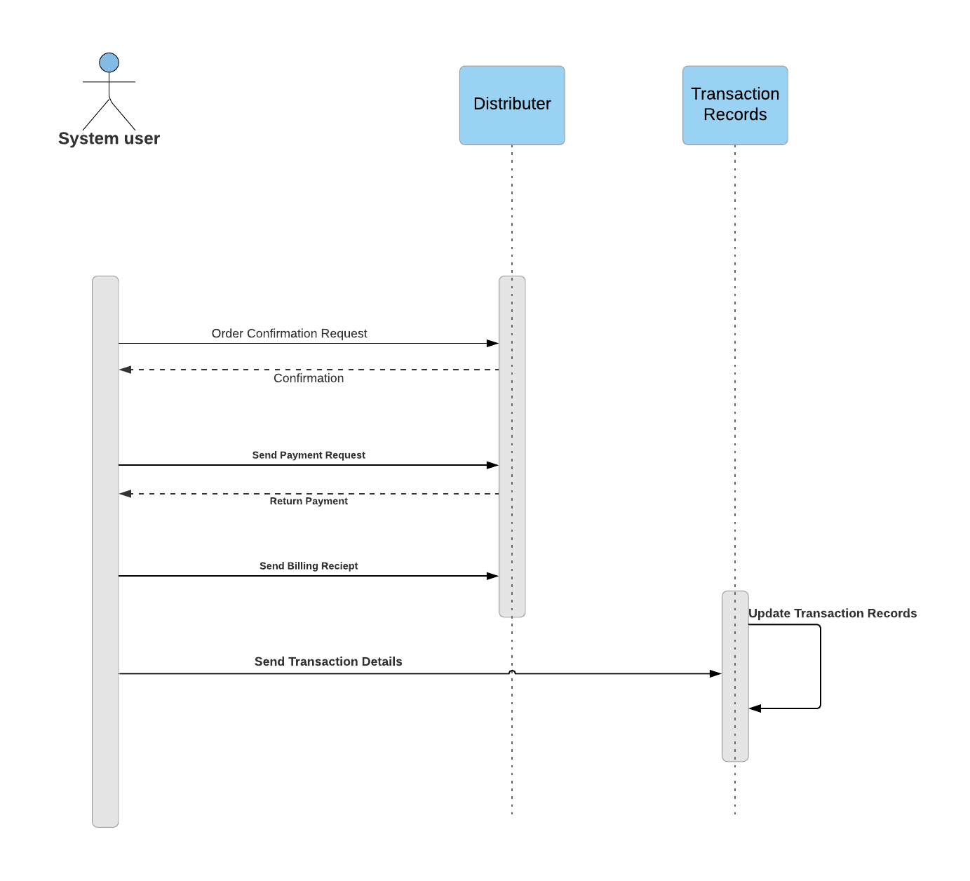
Sequence Diagram: Distributer Payment

Slide 10
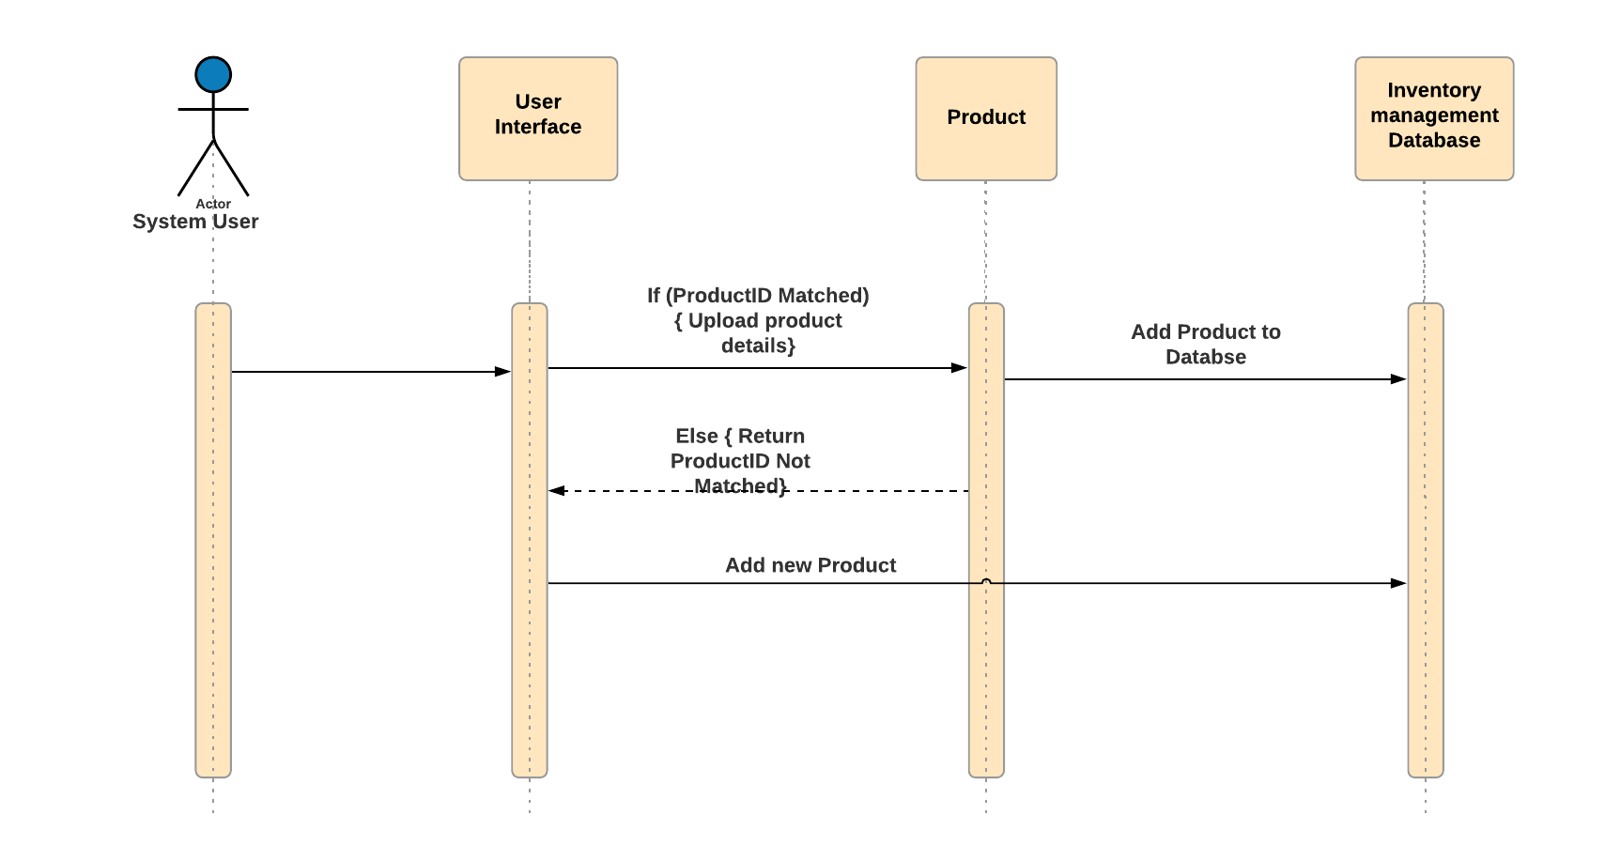
Sequence Diagram: Adding Finished Product to Inventory Database

Slide 11
Thank You!

